Slide 1
The Hong Kong & China Gas Company Ltd.
Negotiating Joint Ventures in China
Team China Case Study
Steve Brown, Monica Davis, Quinn Pierson, Courtney Powers,
Kristen Schmaeling, & Sara Seigel

Slide 2
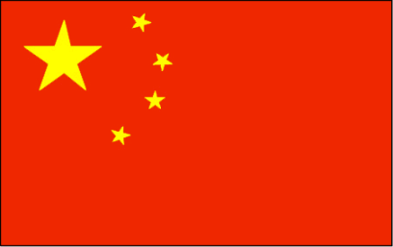
HKCG Background
Founded in 1862 as Hong Kong’s first public utility
Negotiated entry into People’s Republic of China (PRC) through gas supply joint venture’s
Core Business:
The production, distribution, and marketing of gas
Over 72% of Hong Kong households
15,000 commercial and industrial customers
Non-entrepreneurial culture
70% of market share

Slide 3
Key Issue: Future Growth
Changing customer-base
Various options for expansion
Strategy:
Focus on gas supply and distribution in China
Utilize extensive expertise from Hong Kong
Replicate success across the border in the PRC

Slide 4
Alfred Chan
Over 30 years experience in Hong Kong’s industrial and utility sector
Joined HKCG in 1992
Appointed Managing Director in 1997
Strong hands-on approach
New and unfamiliar challenge for top executives
“You have to go to the front line and observe what is happening”
Future success of company is dependent on team’s understanding of customer relationships

Slide 5
Going to China
First entrance into the RPC was in 1994
Zhongshan
Panyu
In response to booming economy, adopted a phased strategy
In 1998 developed JV in over 30 cities
Peter Wong
2002: HCIL was established
2005: Head of China Business
2007
More than 80 JV in PRC
Served 10 million households
Gas and water business grew 119%
Joint Ventures
6 JV a year
30%-80% equity share

Slide 6
The PRC Gas Supply Market
2007
PRC to eliminate pollutants 10% in 5 yrs
11th largest natural gas provider
Natural gas was 3% of total energy use
Natural gas usage expected to increase 10%-15% by 2015
Market provided 2 main growth areas
Downstream
Midstream

Slide 7
Negotiating Joint Ventures in China
At Hong Kong China Gas, all People Republic of China related joint venture projects are coordinated by the Business Division, with outer departments – project support, marketing, finance, and legal – operating independently.
This approach is different from other firms where the business division is put in charge but all other departments report to it
Identifying Projects | Business Division
Consent for JV | Business Division, Legal Department
Due Dilligence | Project Team: Business Division. Marketing/Finance/Legal Departments
Asset Valuation | Both parties appoint a 3rd party independent and internationally accredited asset evaluation organization
Economic Analysis | Finanace Departemnt
Executive Committee Meeting | Executive Committee
M&A Negotiation | Business Division, Legal Department
Signing Agreement | Business Division, Legal Department

Slide 8
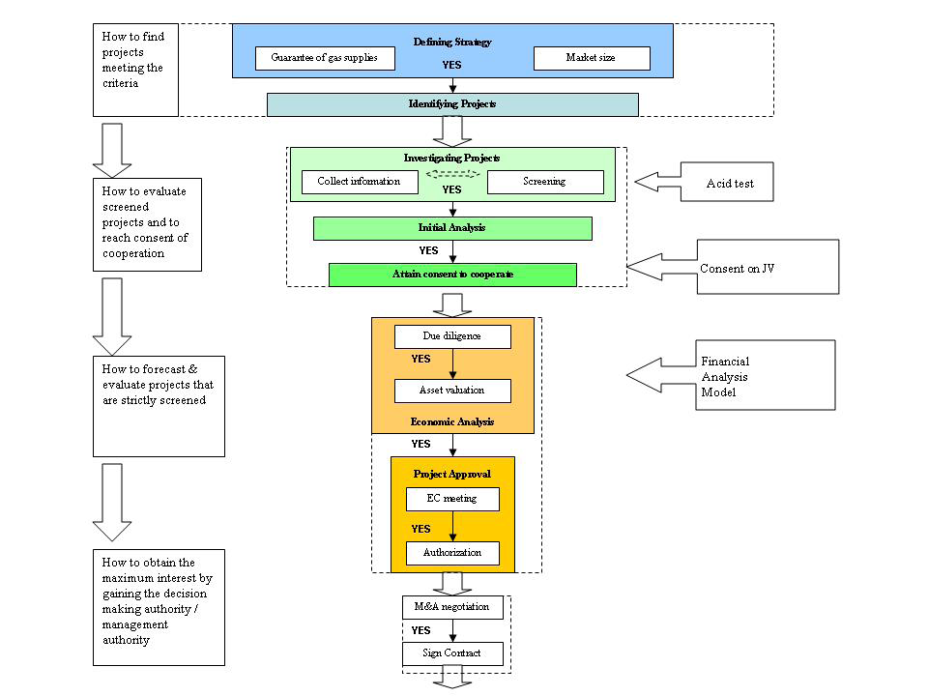

Slide 9
Setup: Target Identification and Party Mapping
Geographically Diverse Team Members
Identify Attractive Prospect
Various Approvals from Authorities
Size of Deal
Building with Chinese Authorities
Negotiation Process

Slide 10
Setup: “Social Mapping” and Guanxi
Identifying Key Decision Makers
Social Mapping at Three Levels
Level 1: External Sources
Level 2: Persuading Target Company Personnel
Level 3: Specialized Target Company Staff
Guanxi

Slide 11
Exclusivity
Difficult to get written confirmation of oral negotiation commitments
When given it was: general, ambiguous, or had flexible interpretation
This could work in HKCG’s favor when rapidly expanding cities would request service outside the original concession
Frequently there were no incumbent gas companies; allowing for HKCG to lay pipe in areas where there previously was no service
The government would not object to this
Viewed as a move to spur new development
Potential Conflicts; only arose when an incumbent company was being encroached by an area being served by HKCG.

Slide 12
Negotiating equity
Medium to large city gas supply projects
50% state owned
Privately operated gas supply projects
51% or greater equity share
Newly developed projects
Both parties invested cash
HKCG had absolute control with 70% or greater equity share
In cases where the JV partner wanted more than 51% share (if they wanted an IPO later on), further compromises had to be made
Example: Cross staffing for better control of the JV’s day to day operations
Sometimes even owning 60% may not be enough to force decisions on the JV

Slide 13
Management Control
Allowed PRC to appoint the chairman of the board
Senior management, like the General Manager and Financial Controllers; often reluctant to cede management control
Resistance from those who felt jobs were threatened
Reassured competent executives and employees
Officials not part of the company
Emphasized the positives
Employed the use of a strategy committee
Coping with budget deadlocks for the next year

Slide 14
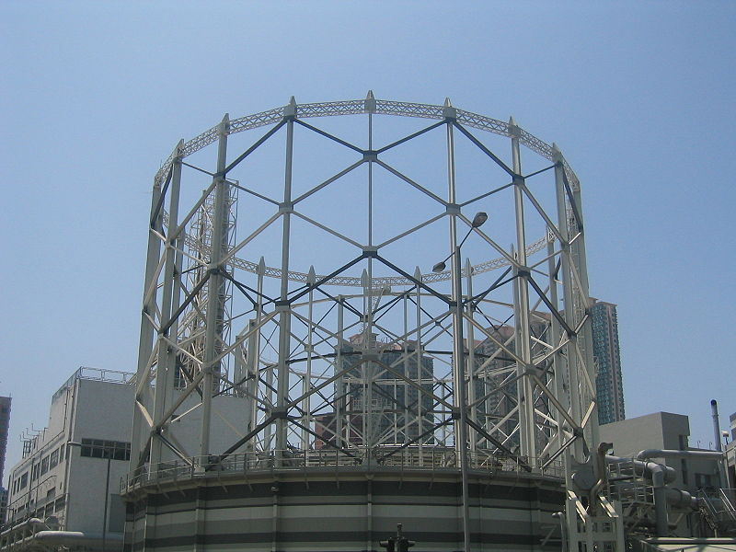
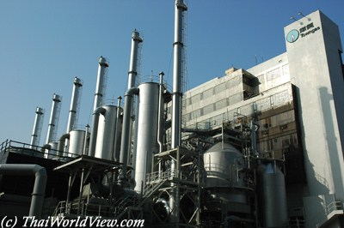
Some images

Slide 15
Negotiating Asset Valuation
Asset pricing is pivotal part in negotiation process
Core assets are priced by mutually appointed independent organization
But valuation still proved challenging because of SASAC
Had mandate to ensure full price for state asset sales
Also political benefit for getting high price concessions from “foreign” purchasers

Slide 16
Negotiating Staffing
Often challenges with negotiating future staff of JV
PRC company reluctant to fire redundant employees
Keeping them on increases cost of JV
HKCG used innovative strategies to deal with this such as creating special reserves
Long term liabilities on balance sheet to cover employee retirement costs
HKCG also expanded businesses and services to absorb extra employees

Slide 17
Looking Forward
HKCG continues to look for opportunities using the skills they have learned thus far in PRC
In 2007 HKCG acquired 43.9% stake in Panvas Gas Holdings
But areas of concern are:
Government policies, especially tariffs
Privately held gas/water companies
Due diligence required to address corporate governance concerns
Moving forward, HKCG is looking to expand more upstream and into alternative/greener energy

Slide 18
Case Question 1
What problems did HKCG encounter in delivering 5-6 new joint ventures annually?
Was this strategy too aggressive?

Slide 19
Answer:
Problems
Chinese Government
No one size fits all strategy
Convincing officials HKCG was the “right” partner
Too Aggressive?
Aggressive, but successful

Slide 20
Case Question 2
Describe the social mapping process
Why was it necessary?
Would this be advantageous in dealing with other global contract negotiations?
For example, in the U.S.?
How does this process mesh with the formal HKCG negotiation process?

Slide 21
Answer
Social Mapping Process
Indentifying key decision makers
Applying three-level analysis approach
Gain information on target company for future JV
Why was it necessary?
Chinese culture’s emphasis on trusted relationships
Accelerate negotiation process
Advantages in other global contract negotiations?
Developed Countries
How does process mesh with formal HKCH negotiation process?
Facts about external environment
Target company’s internal operations

Slide 22
Case Question 3
What lessons did HKCG learn from the experience that carried over into future negotiations?

Slide 23
Answer
Ongoing Ventures
“Strategy Committees”
Use caution with privately-held gas or water firms
Significant Due Diligence
Corporate Governance
Prudent Payments
New Opportunities
Closely related to core businesses
High barriers to entry
Reasonable economic returns
Upstream Operations
Alternative energy and cleaner fuels
Acid Test
Guanxi

Slide 24
Case Question 4
How would you characterize Joint Venture investment in China?
What role does the government play?
Business culture? Firm culture?

Slide 25
Answer
The state is often a major shareholder, and development coordinator
Government revision on tariff structures
Strong positive working relationship
Key for being seen as the ‘right’ partner for development
Business Cultures
Must be handled delicately
People concerned about their power base and job security
The Firm Culture
Aim to develop strong Guanxi
Observe things on the ‘front lines’
Provide managerial and technical expertise to aid in the PRC’s utility infrastructure development

Slide 26
Case Question 5
What types of future investment opportunities should HKCG pursue?

Slide 27
Answer
HKCG should look to diversify into green and alternative energy
Green energy is very “in” right now and the PRC has received criticism over being too harmful to the environment
This has lead China to make a push into cleaner energy
Last year VC and PE investment in green technology jumped 120% to $1.3 billion
HKCG should use this growing market to their advantage
Examples:
Converting heavy diesel trucks to operate on natural gas
Utilizing landfill gas

Slide 28
Questions for the class
We have PRIZES!

Slide 29
Question 1
What international strategy does HKCG use for expansion?
Wholly-Owned Subsidiaries
Mergers & Acquisitions
Joint Ventures
Strategic Alliances

Slide 30
Question 2
What strategies did HKCG use in order to build trusted relationships with various business associates?
Guanxi
Social Mapping
Party Mapping
All of the above

Slide 31
Question 3
What was established to manage HKCG’s investment in the PRC?
Hong Kong and China Gas Incorporated (HKCGI)
Hong Kong and China Gas Investment Ltd (HCIL)
Hong Kong and China Gas United (HKUNITED)
None of the above

Slide 32
Question 4
If the deal size is over RMB 100 million
where does HKCG have to get
approval from?
Beijing
Hong Kong
The United States
Local Government

Slide 33
Questions?
Thank you!
Thank you!
Thank you!

Slide 34
Works Cited
http://www.towngas.com/tgweb/eng/common/home.asp
http://hpsweb.honeywell.com/Cultures/en-US/NewsEvents/SuccessStories/success_HongkongChinaGas_ProcessControlsafety.htm
http://www.powerscorecard.org/tech_detail.cfm?resource_id=5
http://www.chinadaily.com.cn/bizchina/2009-03/16/content_7581521.htm
http://www.tmcnet.com/usubmit/2009/03/22/4074430.htm

